Slide 1
Information Security Portal
Jay Gandhi(201506100110138)
Project Guide : Mr. Hardik Vyas(Assistant Professor)

Slide 2
Project Definition
The system will provide facilities to Admin and Visitor user to manage the Information Security data and documents for the organization.

Slide 3
Software Requirement Specification

Slide 4
Purpose
The Purpose of this system is to reduce the work load and paper work of the Admin and its user. By using this system the Admin can save the time reduces cost and use this system any where.

Slide 5
Scope
The Information Security CTO has to do paper works for managing logs, policies, procedures, guidelines. The Information Security CTO no need to seat at single space, they can use this system any where by using of internet. By using this system, it increases to reducing the paper woks. The system will use any where with the use of internet service provider. The system will maintain the time and cost of the Information Security CTO.

Slide 6
Technology used
Backend :-
Microsoft SQL server 2012
Asp.net with MVC
.NET framework 4.6
Umlet
Frontend :-
Html, css, java script, jQuery, Ajax

Slide 7
Introduction
The Information security management system is the system to manage the important documents, policy, procedure, dashboard and logs in the organization. The system is specially made for the Admin (Information Security CTO). It is developed the maintain the logs, polices, procedure, dashboard, document library and help Admin of the organization to reduce paper work and can get reports of the events

Slide 8
System Users
Admin (Information Security CTO)
User

Slide 9
Functional Requirement
Admin (Information Security CTO)
The views of the admin side must be displayed role wise.
Admin can manage the dashboard.
Admin can manage the Information Security Awareness.
Admin can manage the document library.
Admin can manage the Logs.

Slide 10
Functional Requirement
Admin can manage the Policies.
Admin can manage the Procedure.
The document file of the policy and procedure should be automatically system generated update its content when the policy or procedure are renewed.
The system should have facilities to renew the policy and procedure in bulk.

Slide 11
Functional Requirement
The policy and procedure document should be updated automatically when the policy and procedure are approved.
The system should have facilities to approve the policy and procedure in bulk.
The notification must be generated if the policies or procedures are not approved.
The dashboard contain the basic blogs to view information.

Slide 12
Functional Requirement
User
Admin can manage the Logs.
Logs can be manage the role wise.
Mail must be triggered to notify for adding the monthly new log.
Once log is submitted after that new entry should not be attempt.

Slide 13
Functional Requirement
Reports should be generated by the system like
Total number of the records(category wise)
Total number of the records(Sub category wise)
Total number of policy with symbolic representation for validity
Total number of procedure with symbolic representation for validity
Total number of logs for current year (Bird Eye View)
All document must show in document viewer

Slide 14
Non-functional Requirement
Usability
This system provide good enough and proper GUI format with responsive and user friendly.
Security
In this system, login can be possible using windows authentication or using web references.

Slide 15
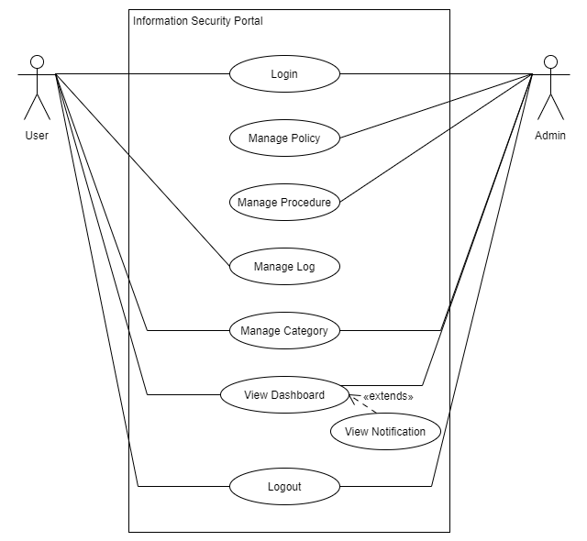
Usecase Diagram

Slide 16
Activity Diagram
Login

Slide 17
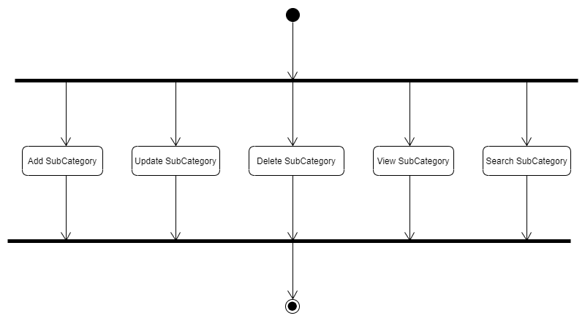
Activity Diagram
Sub Category Manage

Slide 18
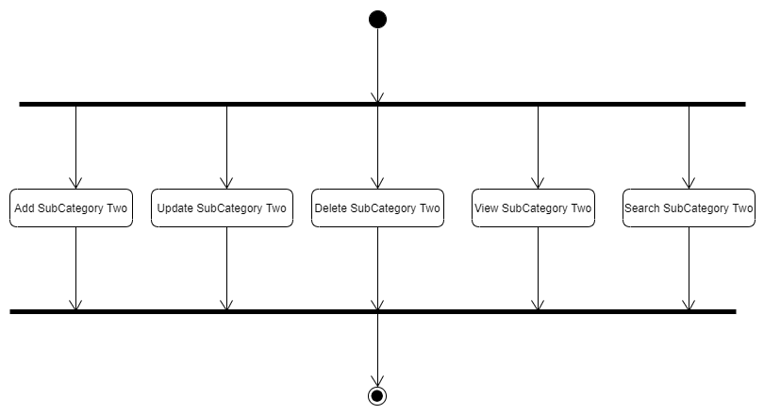
Activity Diagram
Sub Category Two Manage

Slide 19
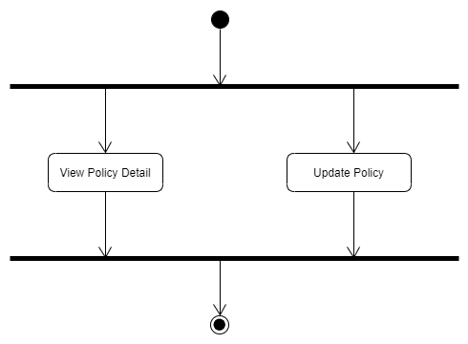
Activity Diagram
Policy detail

Slide 20
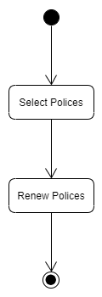
Activity Diagram
Policy Renew In Bulk

Slide 21
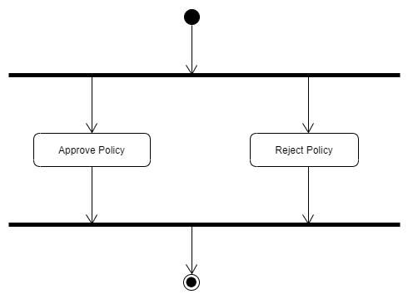
Activity Diagram
Policy Approve

Slide 22
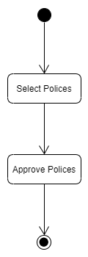
Activity Diagram
Policy Approve In Bulk

Slide 23
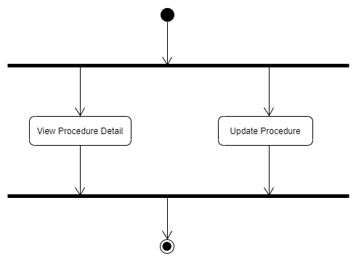
Activity Diagram
Procedure Detail

Slide 24
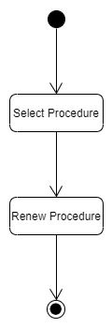
Activity Diagram
Procedure Renew in bulk

Slide 25

Activity Diagram
Procedure Approve

Slide 26
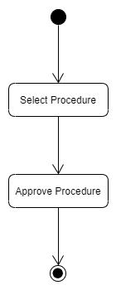
Activity Diagram
Procedure Approve In Bulk

Slide 27
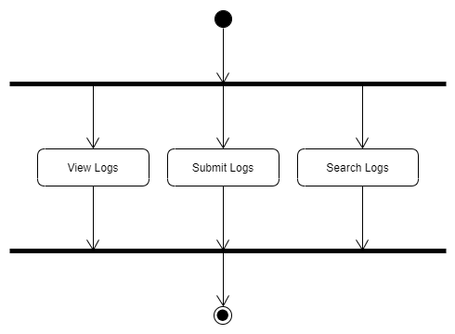
Activity Diagram
Log Detail

Slide 28
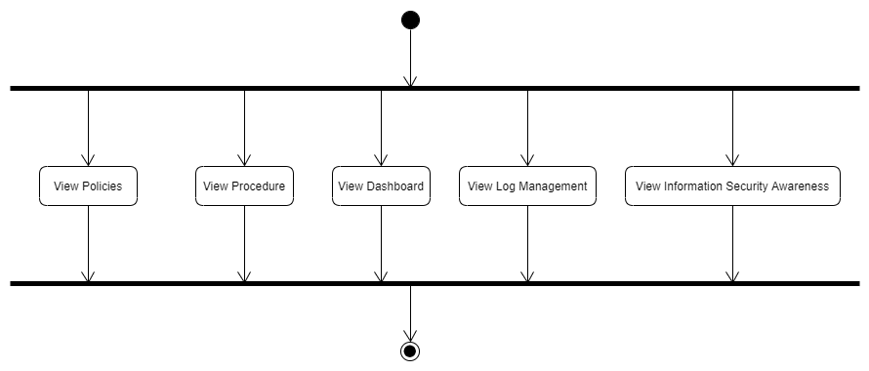
Activity Diagram
Visitor

Slide 29
Data Dictionary
Tables:-
Tbl_Category
Tbl_SubCategory
Tbl_SubCategoryTwo
Tbl_LogDetails
Tbl_PolicyProcedure_Details

Slide 30
Data Dictionary
Tbl_Category
Filed Name | Datatype | Description
Category_ID | Int | Primary Key of the table
CategoryName | Varchar(50) | Name of the category
Description | Varchar(150) | Description of the Category
ImageUrl | Varchar(200) | Image url of the category

Slide 31
Data Dictionary
Tbl_SubCategory
Filed Name | Datatype | Description
SubCategory_Id | Int | Primary Key of the table
Category_FK_ID | Int | Foreign Key of the category table
SubCategoryName | Varchar(50) | Name of the sub category
ResponsiblePerson | Varchar(50) | Responsible person for the log
ResponsiblePersonManager | Varchar(50) | Responsible person manager for the log
SubcategoryUrl | Varchar(150) | Url for the sub category(Dashboard)

Slide 32
Data Dictionary
Tbl_SubCategoryTwo
Filed Name | Datatype | Description
SubCategoryTwo_Id | Int | Primary Key of the table
SubCategory_FK_Id | Int | Foreign Key of the sub category table
SubCategoryTwoName | Varchar(50) | Name of the sub category two
DocPath | Varchar(200) | Path url of the sub category two
Description | Varchar(150) | Description for sub category two
ImageUrl | Varchar(150) | Image Url for the sub categoryTwo

Slide 33
Data Dictionary
Tbl_LogDetails
Filed Name | Datatype | Description
LogDetails_Id | Int | Primary Key of the table
SubCategoryTwo_FK_Id | Int | Foreign Key of the sub category two table
Month | Varchar(20) | Month of the log
Approver_Remark | Varchar(50) | Remarks for approve log
Status | Varchar(10) | Status of log
ApprovedBy | Varchar(20) | Psno of approved by log
ApprovedOn | DateTime | Date of approved log
SubmittedBy | Varchar(20) | Psno of submitted by log
SubmittedOn | DateTime | Date of submitted log

Slide 34
Data Dictionary
Tbl_PolicyProcedureDetails
Filed Name | Datatype | Description
PolicyProcedure_Id | Int | Primary Key of the table
SubCategoryTwo_FK_Id | Int | Foreign Key of the sub category two table
SectionAffected | Varchar(50) | Sectionn affected of policy or procedure
Approver_Remark | Varchar(50) | Remarks for approve policy or procedure
Status | Varchar(10) | Status of log
ApprovedBy | Varchar(20) | Psno of approved by log
ApprovedOn | DateTime | Date of approved log
SubmittedBy | Varchar(20) | Psno of submitted by log
SubmittedOn | DateTime | Date of submitted log
Version | Varchar(20) | Version of policy or procedure
InitialRemark | Varchar(20) | Remark of policy or procedure
DocPath | Varchar(200) | Path of policy or procedure
Revision | Varchar(10) | Revision Number policy or procedure
IsLeatestRevision | Bit | Revision of policy or procedure least or not

Slide 35
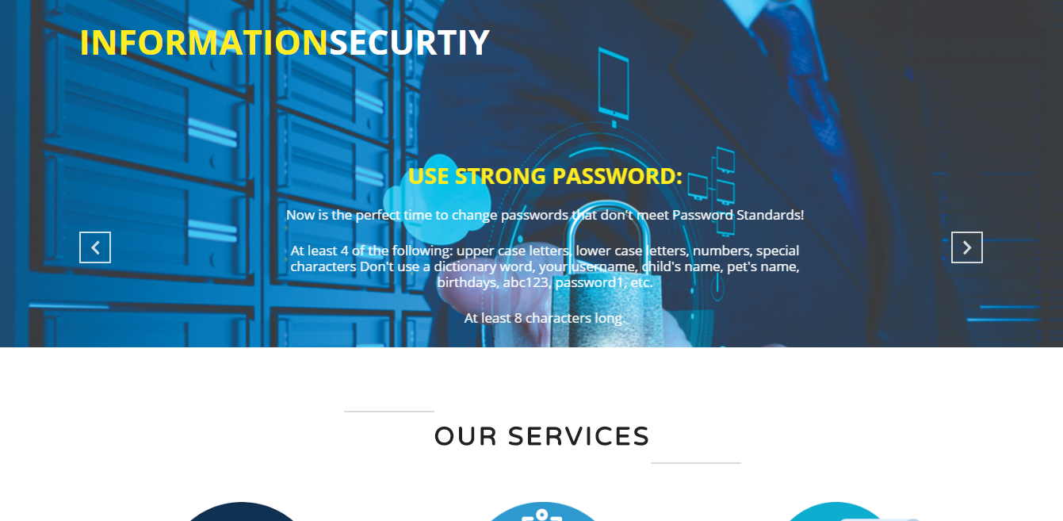
User Interface Design
Main Page(Visitor)

Slide 36
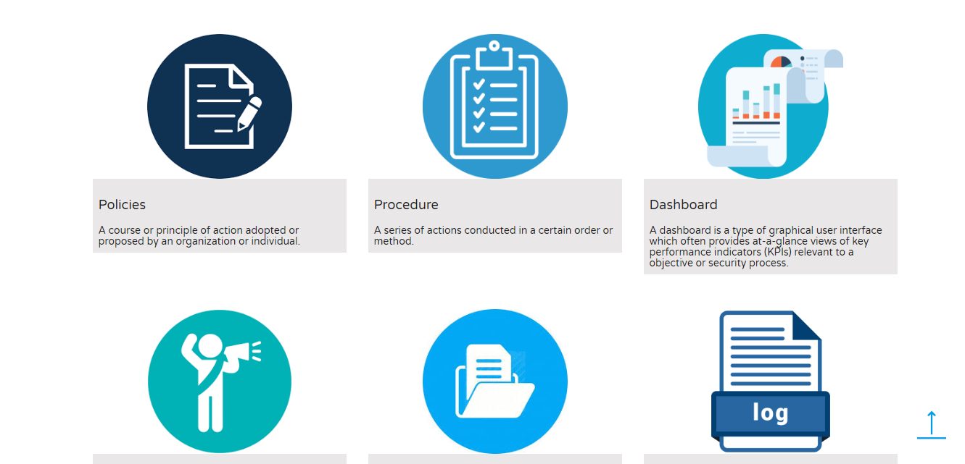
User Interface Design
Main Page(Visitor)

Slide 37
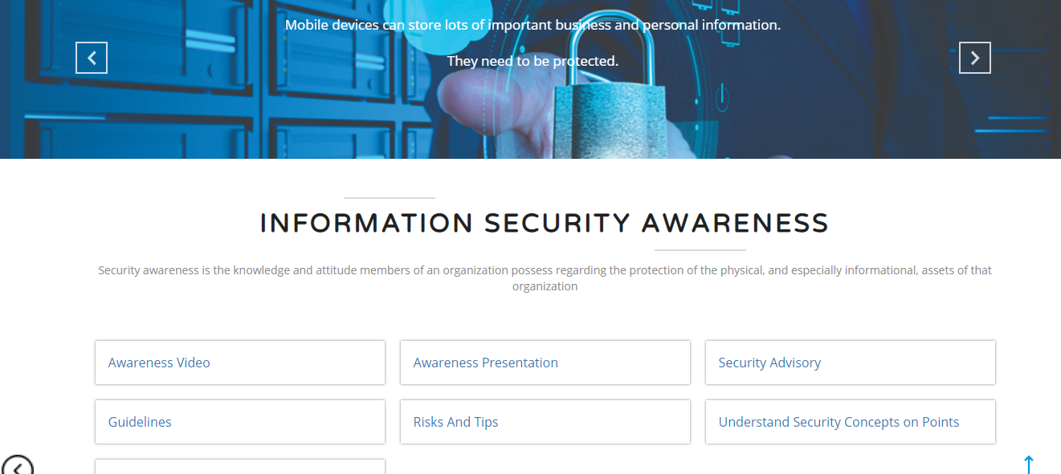
User Interface Design
Information Security Aware (Visitor)

Slide 38
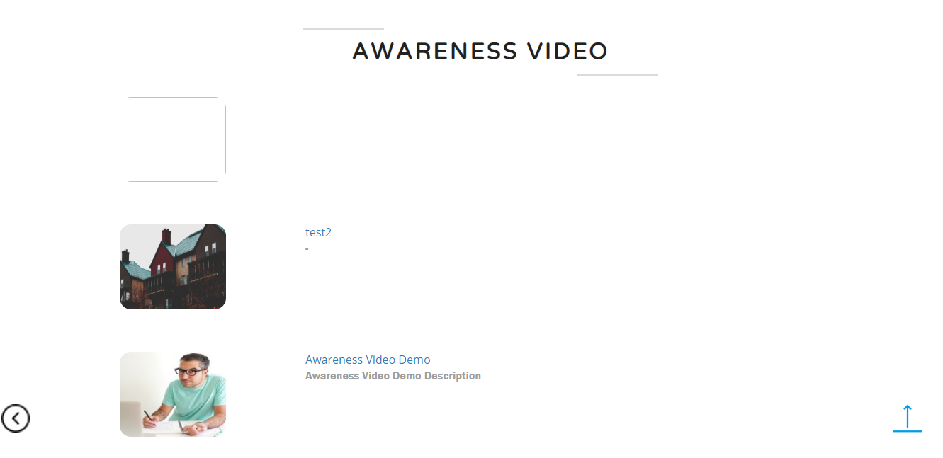
User Interface Design
Information Security Aware (Visitor)

Slide 39
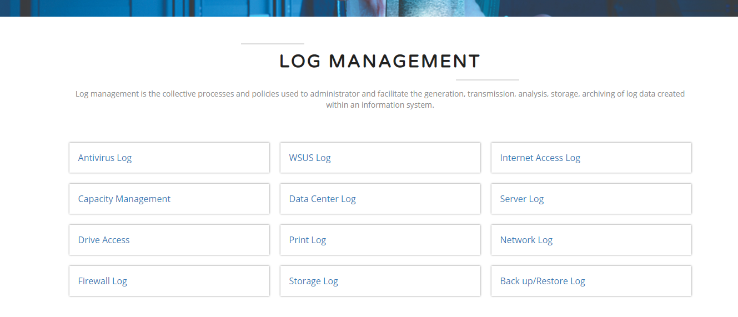
User Interface Design
Log Management (Visitor)

Slide 40
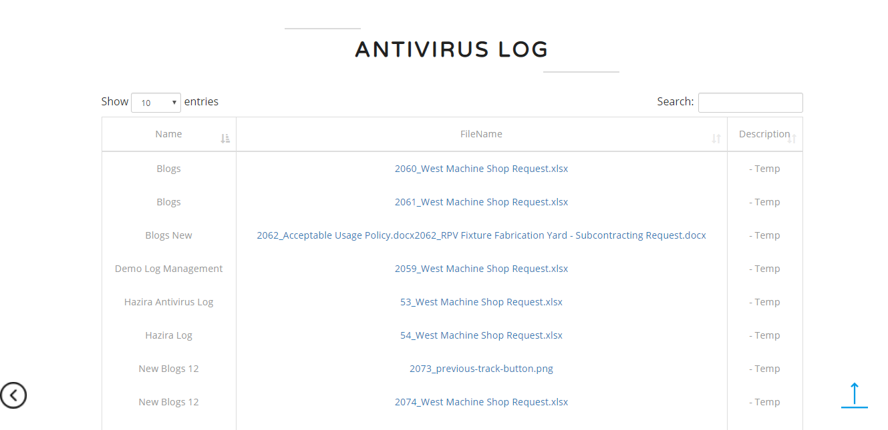
User Interface Design
Log Management (Visitor)

Slide 41
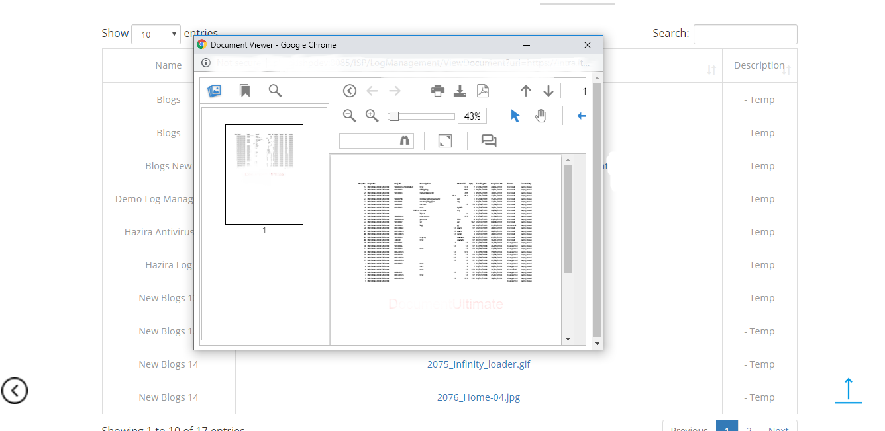
User Interface Design
Log Management (Visitor)

Slide 42
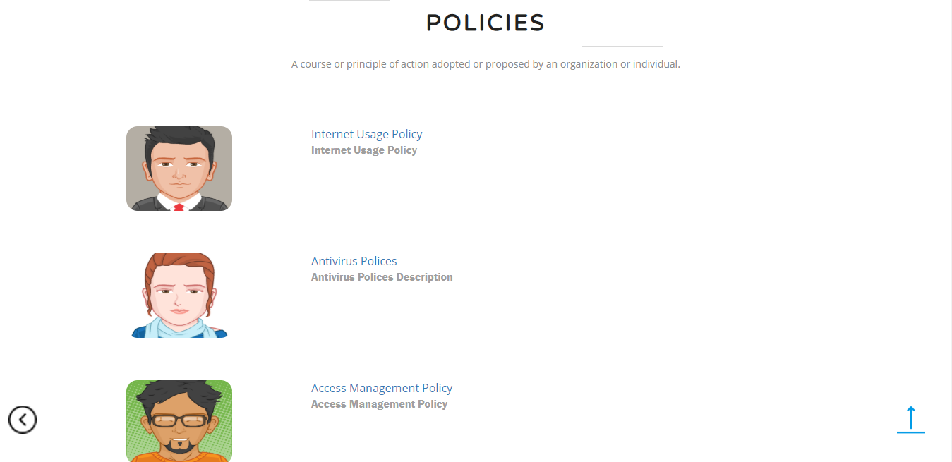
User Interface Design
Polices (Visitor)

Slide 43
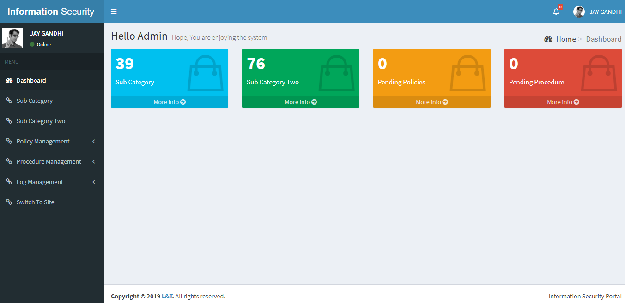
User Interface Design
Admin Dashboard

Slide 44
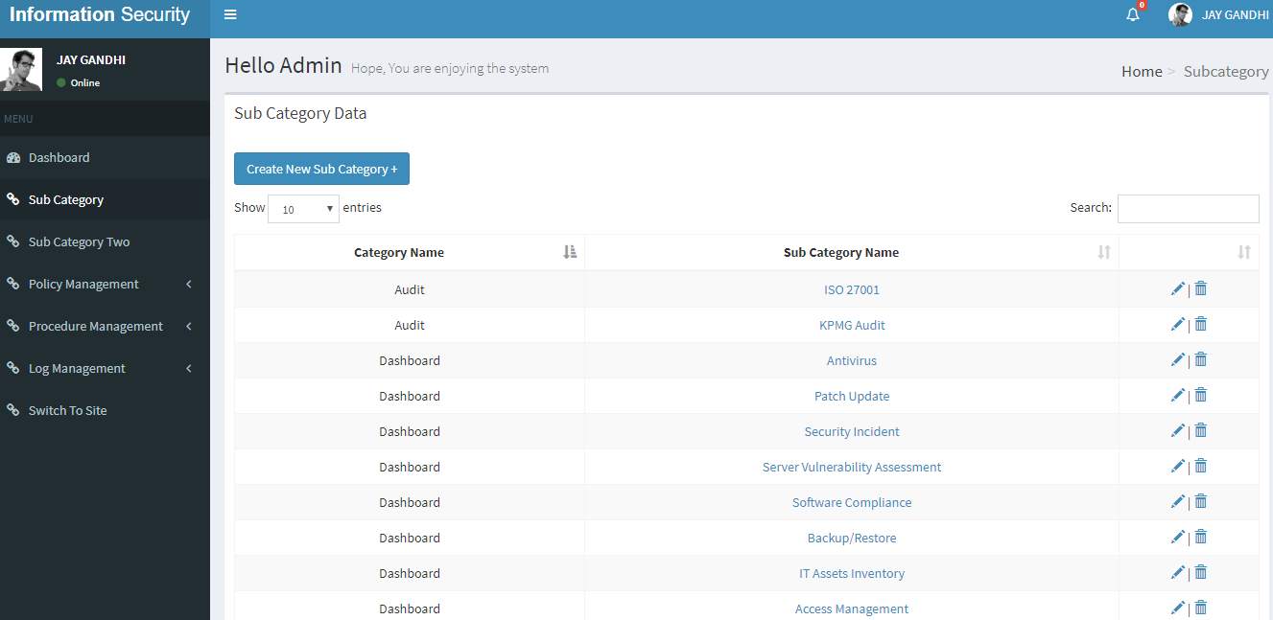
User Interface Design
Admin Sub Category

Slide 45
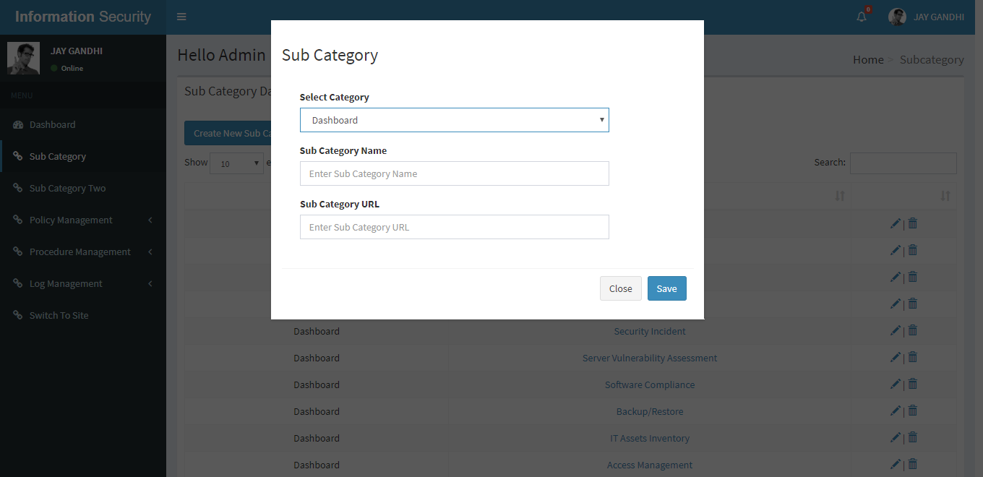
User Interface Design
Admin Sub Category New Entry For Dashboard

Slide 46
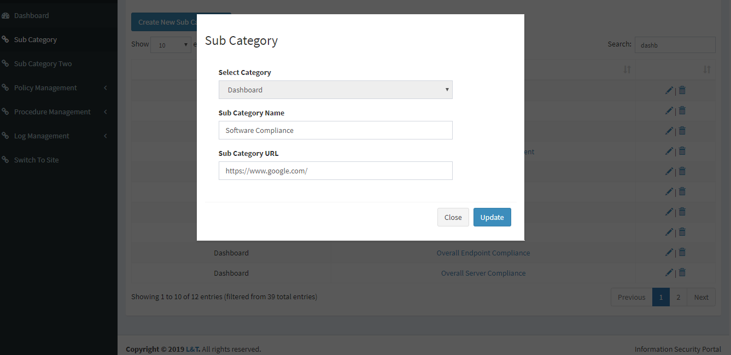
User Interface Design
Admin Sub Category Update Entry For Dashboard

Slide 47
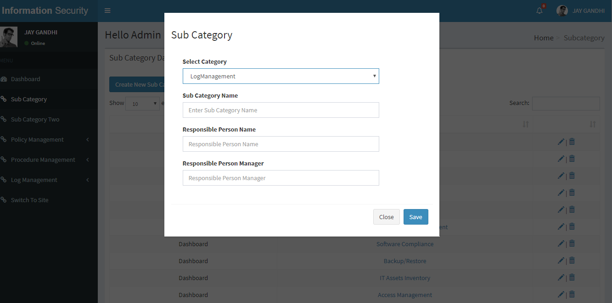
User Interface Design
Admin Sub Category New Entry For Log

Slide 48
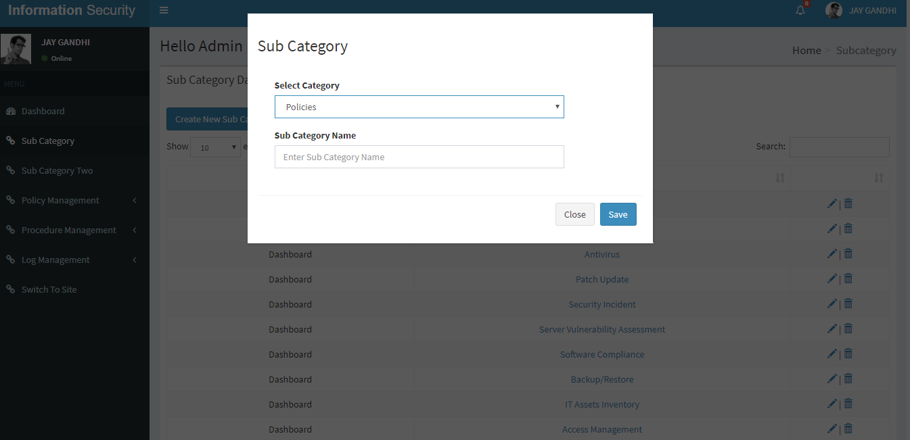
User Interface Design
Admin Sub Category New Entry For Policy And Procedure

Slide 49
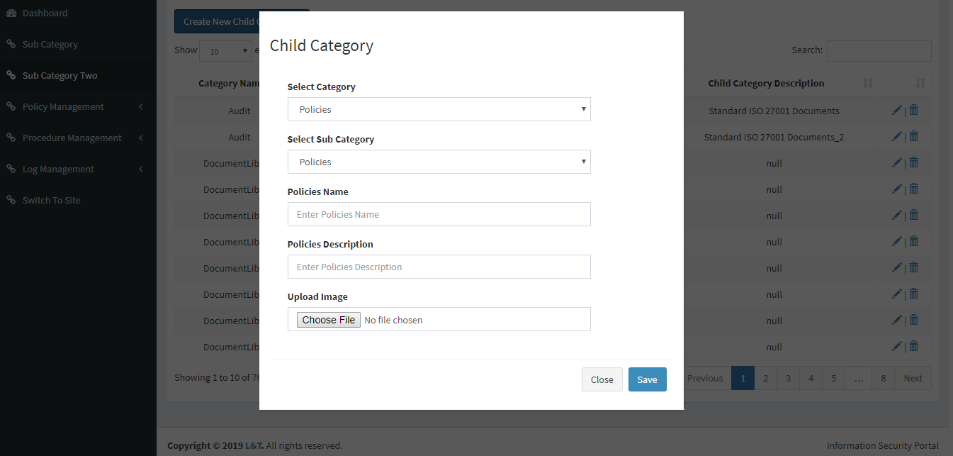
User Interface Design
Admin Sub Category Two New Policy

Slide 50
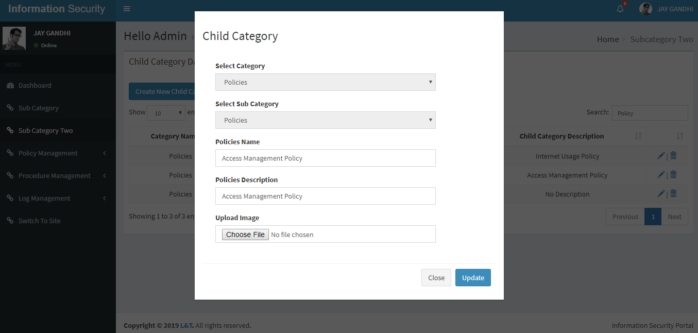
User Interface Design
Admin Sub Category Two Edit Policy

Slide 51
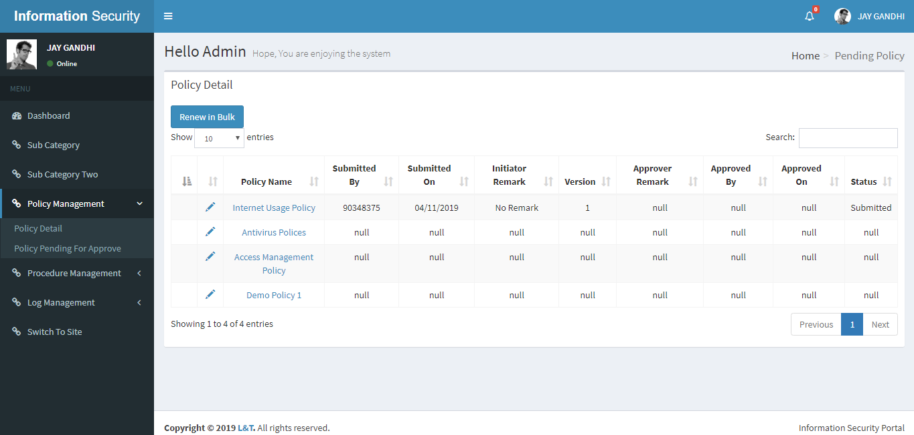
User Interface Design
Admin Policy Detail / Pending Policy

Slide 52
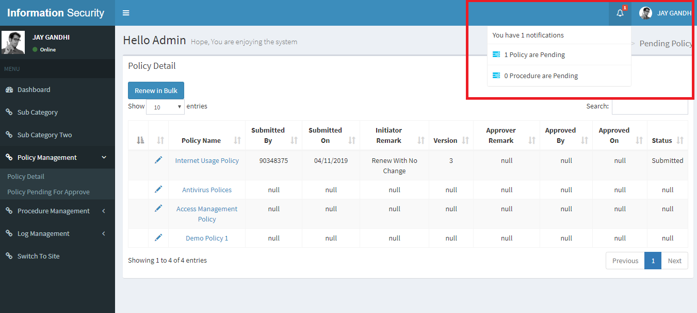
User Interface Design
Admin Policy Detail / Pending Policy with Notification

Slide 53
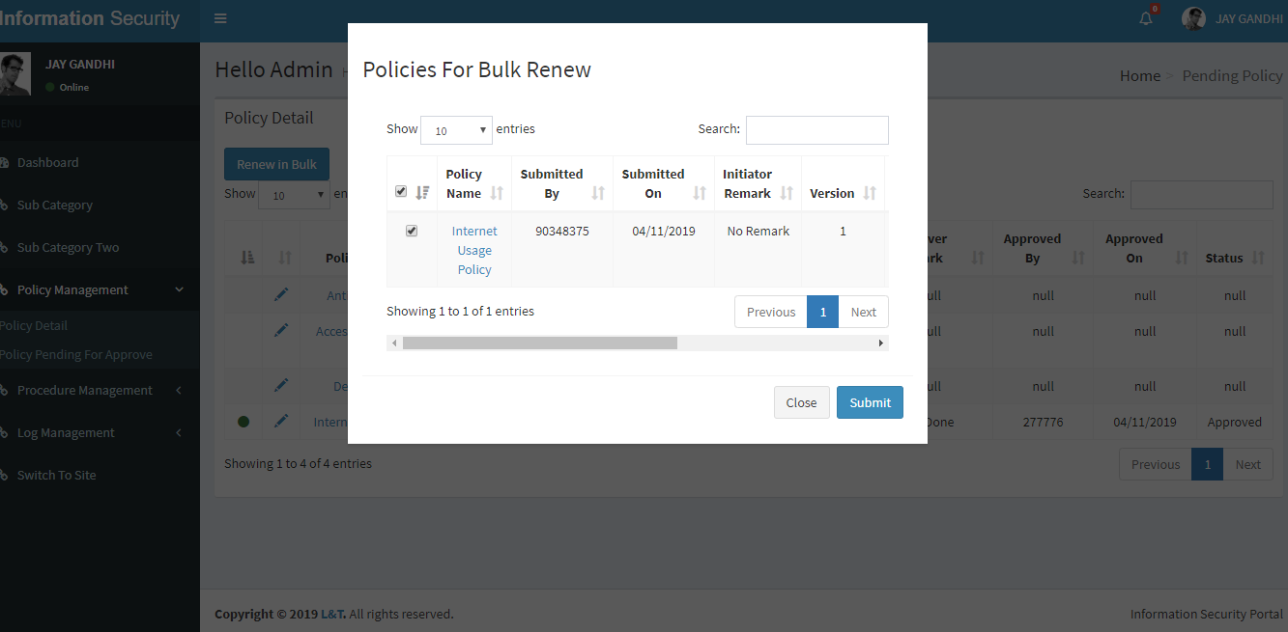
User Interface Design
Admin Policy Renew Bulk Upload With No Change

Slide 54
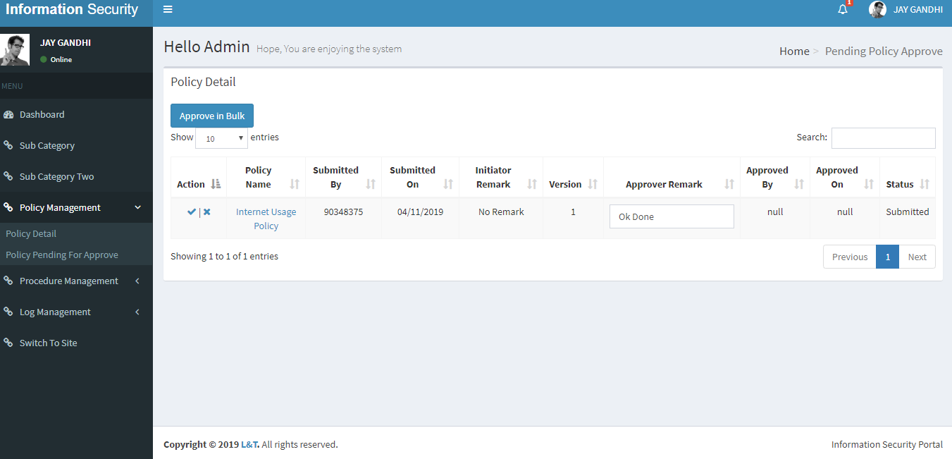
User Interface Design
Admin Policy Detail For Approve

Slide 55
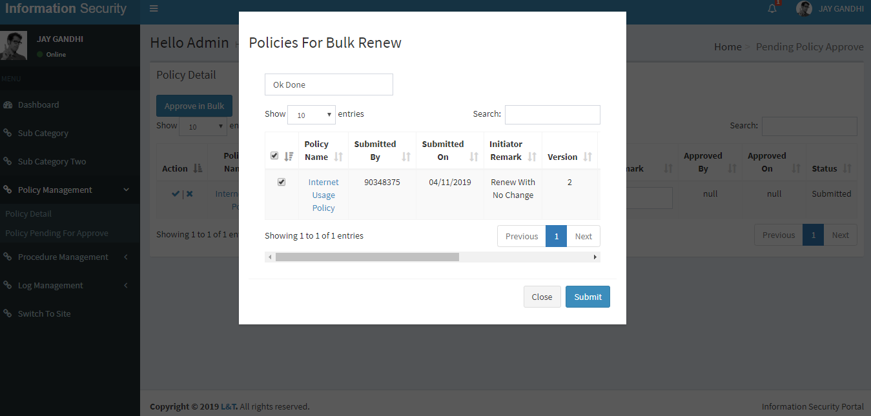
User Interface Design
Admin Policy Detail For Approve in Bulk

Slide 56
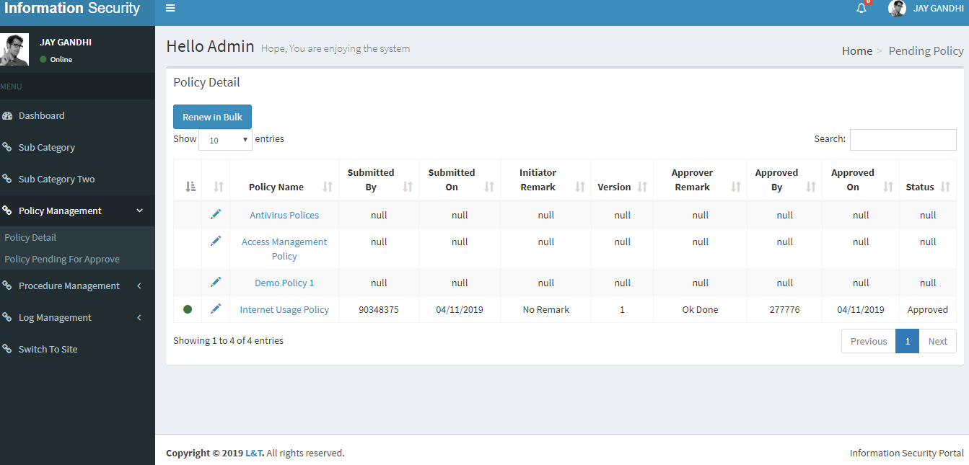
User Interface Design
Admin Policy Detail After Approve(Symbolic Representation)

Slide 57
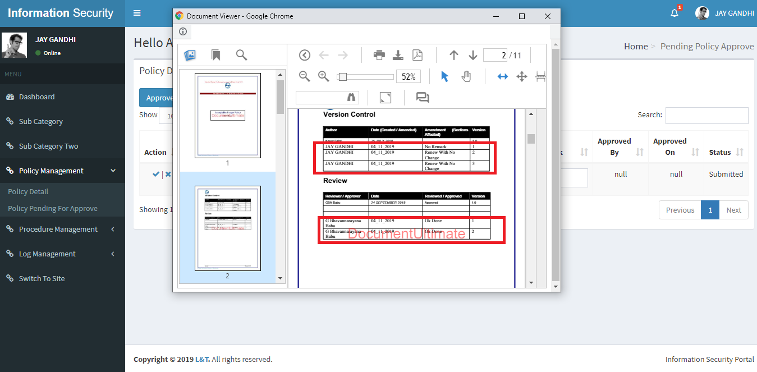
User Interface Design
Admin Policy Detail After Approve(Document Implemetation)

Slide 58
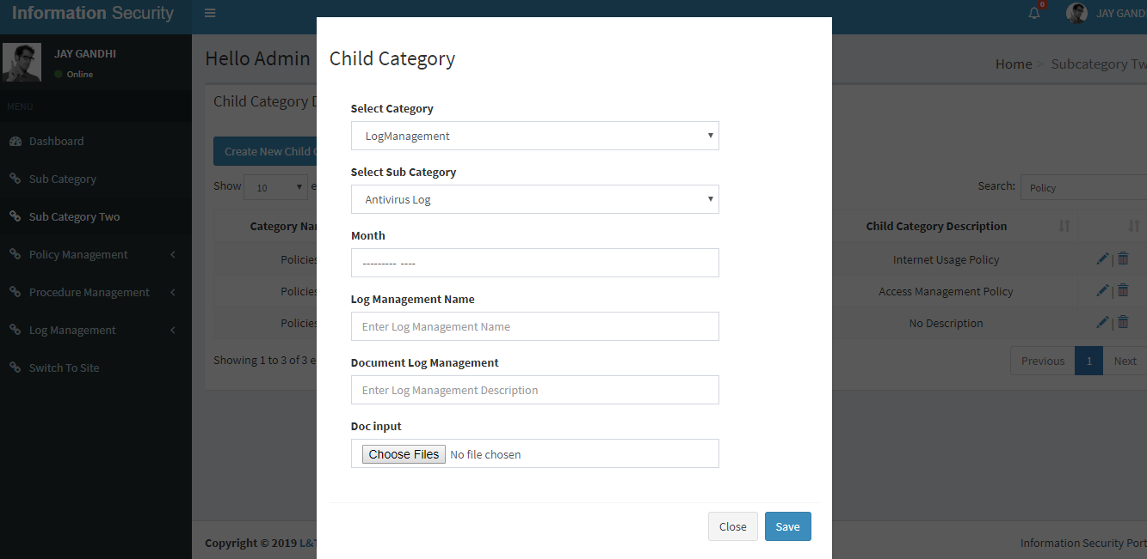
User Interface Design
Admin Sub Category Two New Entry Log

Slide 59
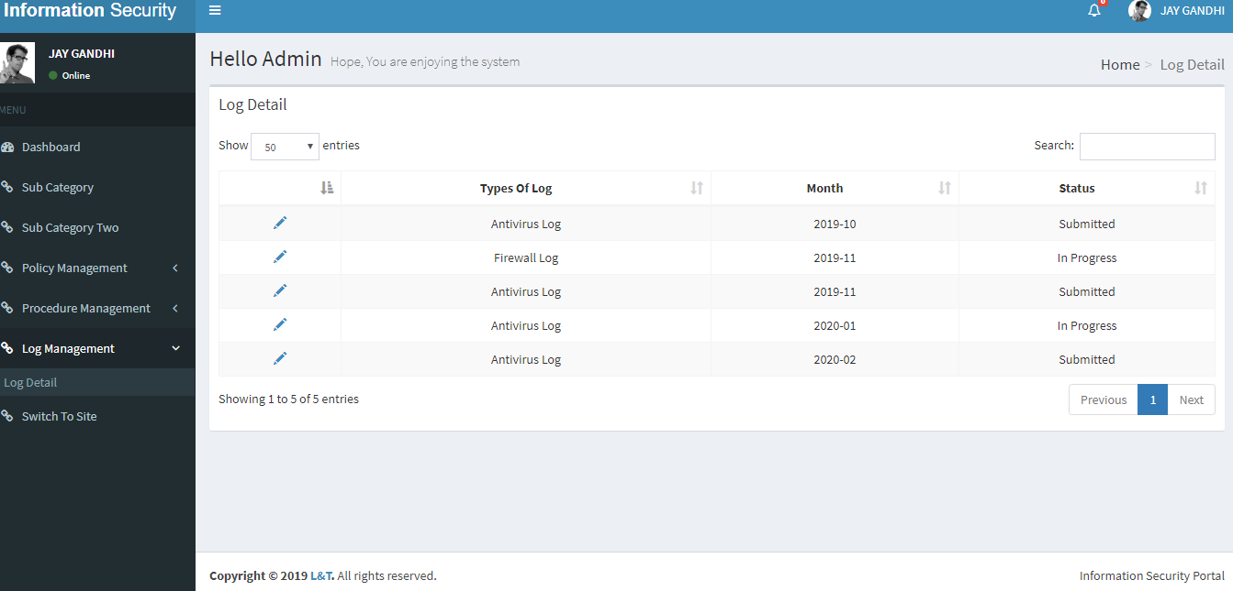
User Interface Design
Admin Log Detail

Slide 60
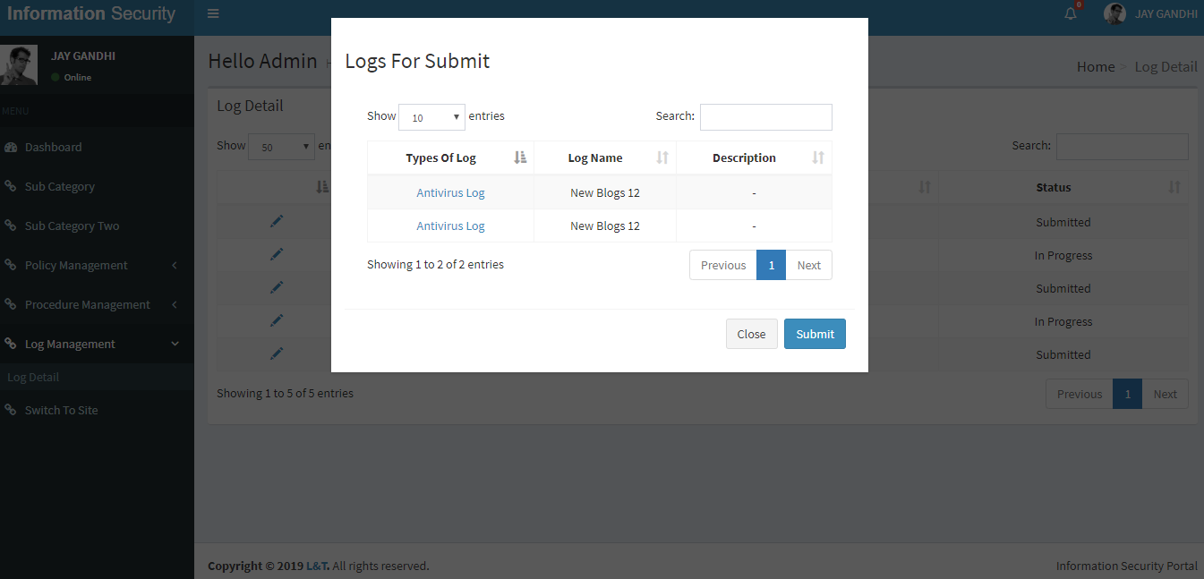
User Interface Design
Admin Log Detail Before Submit

Slide 61
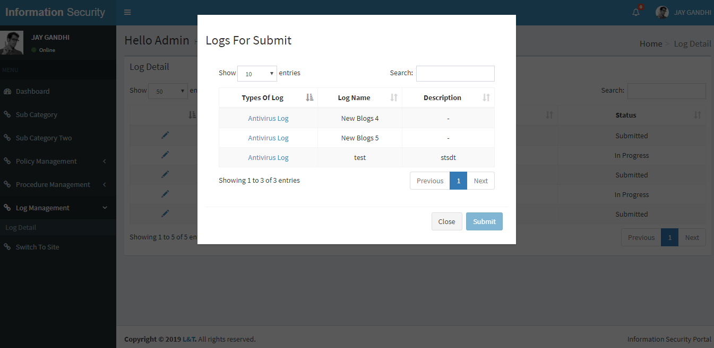
User Interface Design
Admin Log Detail After Submit

